Slide 1
Flight Ticket Booking
Spring mvc + Hibernate + MySqL

Slide 2
technology
Language：
Java
Jsp
Javascript
MySQL
Framework & Libraary：
Spring MVC
JSTL
JQuery
Hibernate/JPA

Slide 3


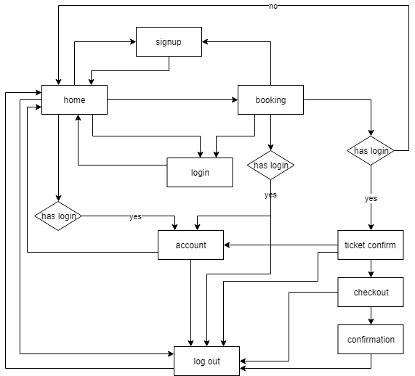
Logic flow chart
7 jsp pages:
Index.jsp(home)
Booking.jsp
Ticketconfirm.jsp
Checkout.jsp
Confirmation.jsp
Accountinfo.jsp
Signup.jsp

Slide 4
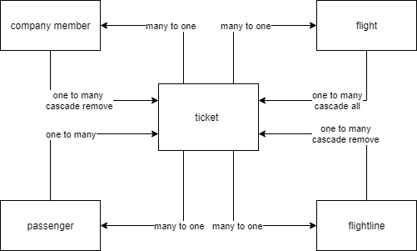
Hibernate/JPA
5 tables
ticket
Filght
Flightline
Passenger
member

Slide 5
Features
Login/Log out/signup
All pages Input validator jquery check
All pagesInput jquery autocomplete implements
Use backtracking algorithm to implements all possible flight combination of flights in a flight line. Between two cities One flight line at most could change flight two times. It means from Chicago ord to Los angles lax, in Booking.jsp, zero stop, one stop, and 2 stops possible flights all will displays in the flight info div. If it is a round trip, at most 6 flights form a flight line
Over night flight will display + 1 day sign
Two hours will keep for passenger who need to change flight
Round Trip will get a 80% discount

Slide 6
Index/home page
Search flights info between two cities depend on one trip or round trip and department day and return day
Filter all possible flights combination by department city and target city, department date and return date, the airline company, the stop number, economy/business cabin choice
All fights info is added into overflow div by jquery and filter all the flights by jquery ajax, do not need load new page.
Booking page
Display all flight lines by price increasing order
Before jump to ticket confirm page , the user must log in

Slide 7
Ticketconfirm page
When input passenger information, the user could change the number of passenger
The user could choose adult or child. The choice will influence the total price
When change the number of passenger, the form to fill passenger information will dynamically changed. Adding a passenger, the personal information form will add one, Decreasing a passenger, the form will delete one.
Checkout page
Checkout page has default checkout checked box, could automatically fill bank information. If no any bank information in database, Message notice will appear
Could update new default bank information

Slide 8
Account info page
Display company member personal information
Display all booking information
Update phone, email, password information
Update default bank card information in a pop up window
Booked flight could delete two hours before the first flight in the flight line departure tim

